Slide 1


INNOVATION.AUTOMATION.ANALYTICS
PROJECT ON
Data-Driven Job Market Analysis for Student and Alumni Career Assistance
Presented by
Mir Aqdas Ali

Slide 2
About me​
Education Background.
B.Com Honours from Avinash College of Commerce, Hyderabad (2024). This academic foundation has given you strong skills in commerce, finance, and analytical thinking.
Why Do you want to learn Data Science.
I want to learn Data Science because it combines my interest in problem-solving with the power of data-driven decision-making. In today’s world, data is at the core of every business and industry, and learning Data Science will help me analyze patterns, extract meaningful insights, and contribute to smarter strategies. I see it as a skill that not only enhances career opportunities but also allows me to create real impact through innovation and technology.
Github
LinkedIn

Slide 3
💼 Business Problem
Educational institutions are under increasing pressure to demonstrate strong placement outcomes for both current students and alumni. However, the job market is highly dynamic: roles, required skills, experience levels, locations, and salary ranges change daily. Manually tracking thousands of job postings across platforms like Naukri.com is impractical, slow, and prone to missing relevant opportunities.
As a result, students and alumni often struggle to identify roles that truly match their qualifications, skills, career goals, and experience levels. Career services teams face similar challenges in providing timely, personalized job recommendations and in understanding market demand to align academic programs with industry needs.
The institution needs a data-driven system that can automatically collect job postings from Naukri.com, structure and analyze them, and match them against student and alumni profiles. The objective is to:
Identify the most suitable job opportunities for each student and alumnus based on skills, education, experience, and preferences.
🎯 OBJECTIVE
Provide real-time or near–real-time job recommendations.
Generate insights on in-demand skills, roles, industries, and salary trends.
Help academic leadership adjust curriculum and training programs based on market demand.
Without such a system, the institution risks lower placement rates, reduced student satisfaction, weaker alumni outcomes, and misalignment between academic offerings and industry requirements.

Slide 4
🤔 Business understanding¶
The education institute aims to improve placement outcomes for its students and alumni by using data-driven job matching. Naukri.com contains a large volume of up-to-date job postings across industries, roles, locations, and experience levels, making it a valuable source of labor market intelligence. The business value includes:
Higher placement and employability rates
Better student satisfaction and institutional reputation
Stronger industry alignment
Data-backed curriculum and training decisions
⚠️ Constraints
Scraped data can be used only for internal academic and placement purposes.
Budget is limited for tools, servers, and technical manpower.
Project must show results before the placement season.
High dependence on external website (Naukri.com) for data availability.
Changes in website structure can disrupt data collection.
Anti-scraping mechanisms may limit data access.
Data quality issues such as duplicates, missing fields, and inconsistent formats.
System must be easy for students and placement teams to use.
Need to protect student and alumni data privacy.
Must follow institutional and legal data security guidelines.

Slide 5

🤷‍♂️ Reason for Choosing Naukri.com as the Job Search Platform
Naukri.com was selected as the primary data source for this project because it is one of India’s largest and most widely used job portals, offering extensive coverage across industries, job roles, experience levels, and locations. The platform provides rich job-related information such as job title, company name, required skills, experience range, location, salary (where disclosed), posting date, and company ratings. Since Naukri.com is actively used by recruiters from both multinational and domestic organizations, it reflects real-time hiring trends and current market demand, making it highly relevant for students and alumni seeking practical and up-to-date career opportunities.
Additionally, Naukri.com supports role-based and location-based job analysis, enabling meaningful insights into high-demand roles, preferred cities, and experience requirements. The availability of company ratings adds value by allowing evaluation of employer quality alongside job availability. From a technical standpoint, the platform presents real-world web scraping challenges such as dynamic content loading and inconsistent page structures, which strengthens the practical and industry relevance of the project. Overall, Naukri.com provides comprehensive, timely, and realistic job market data, making it an ideal choice for building a data-driven job assistance system for students and alumni.

Slide 6
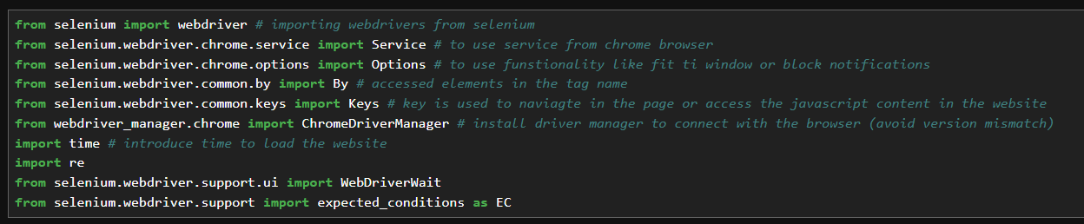
📩 Starting off by installing all the useful libraries
This project uses Python, Selenium, Chrome WebDriver, Pandas, NumPy, SciPy, NLP libraries, and visualization tools and Jupyter Notebook to build an end-to-end, data-driven job assistance system through real-time web scraping and statistical analysis.

Slide 7
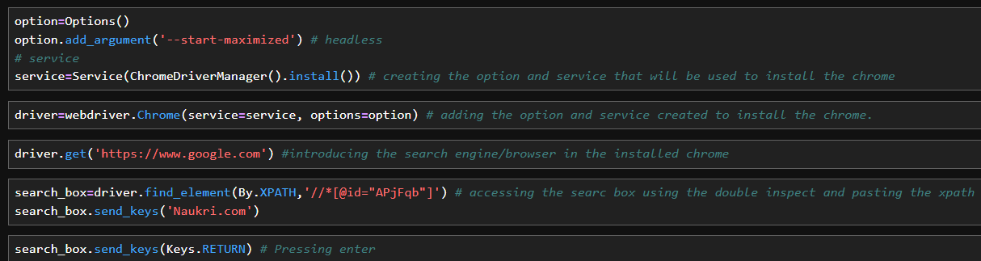
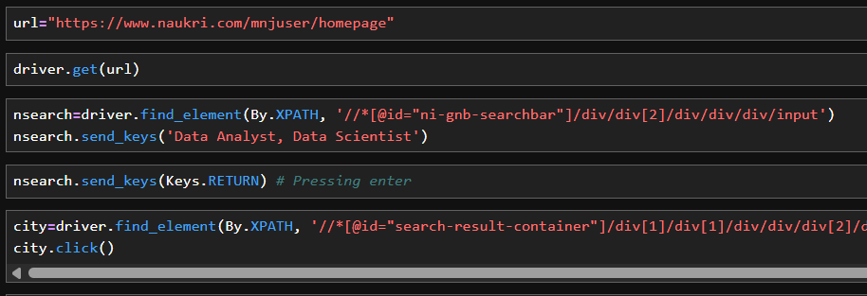
Setting up the browser using the web drivers and searching for the website using Selenium
Feeding the URL and Searching for the Data Scientist Jobs.
Then selecting the city: Hyderabad from filters using the XPATH

Slide 8
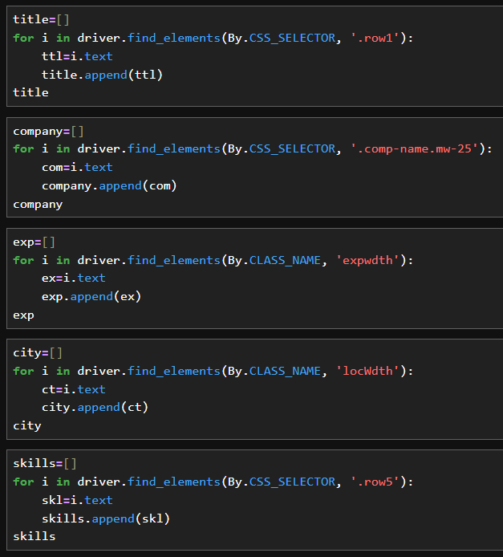
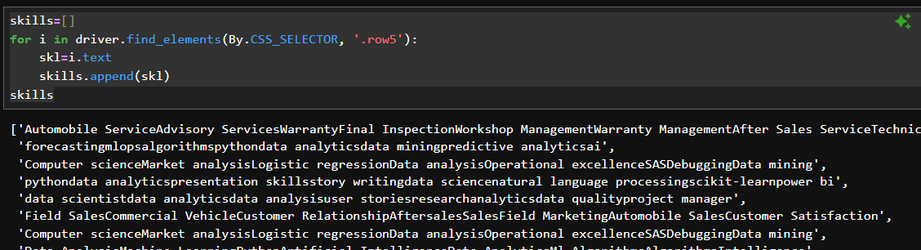
Searched for the relevant features using the CSS_SELECTOR and CLASS_NAME
Then tested to see if the class or css selector is giving the correct value and encountered challenges in the patterns that were resolved using the regex functions to extract the patterns of our choice.
Encountered challenge when extracting the skills that all the words were being attached to next word.
This was resolved using the word tokenization to get break down the words and then get the correct skill

Slide 9
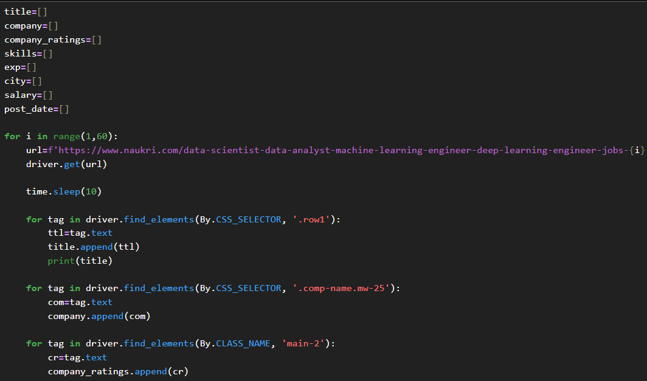
⭐IMPORTANT PART
Once we have all the patterns of the relevant features that we are going to extract from the website we used a FOR loop to extract these patterns from all the pages to get the most amount of jobs.
When using the for loop we assign the page locator in the link as a place holder what will be changed as FOR loop keeps running.
During the same process we also have to ensure that the pages load properly to ensure that correct data from correct page is extracted and to make sure that the next page in the FOR loop is loaded before extracting the patterns we introduced the time sleep that ensures that the page is loaded and ready to be scraped for the patterns in the FOR loop.

Slide 10
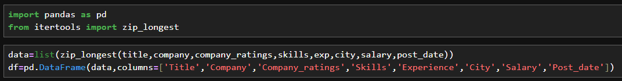
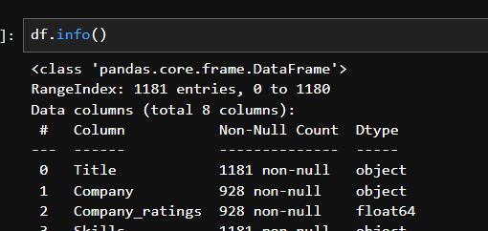
Once we have the data scraped from the desired number of pages and safely stored in the variables, then we use the pandas library and itertools to combine and make a DataFrame from the scraped data.
After verifying the DataFrame is made we can safely store it in a CSV format using the “to_csv” function
Since we have the Data ready now we start the Data-cleaning and EDA

Slide 11
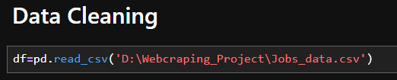
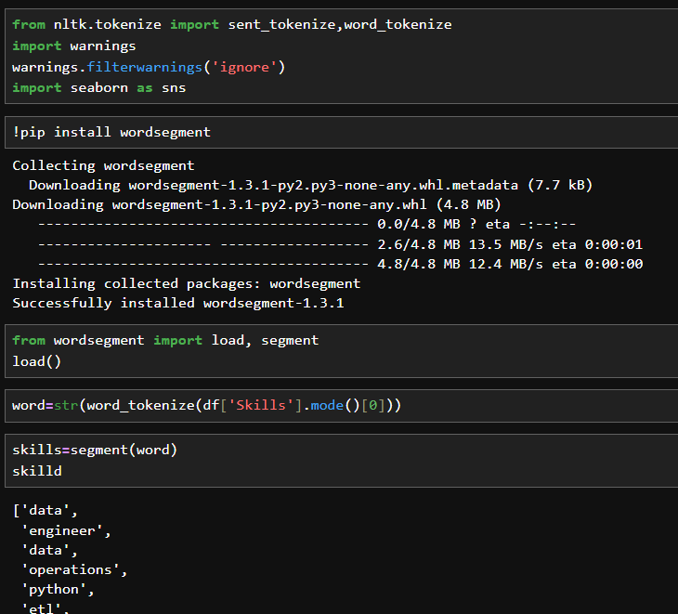
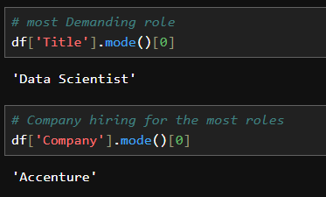
Used nltk and word segment to tokenize the skills and then find the most demanding skill for the jobs.

Slide 12
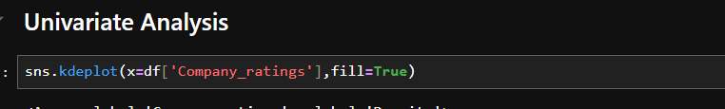
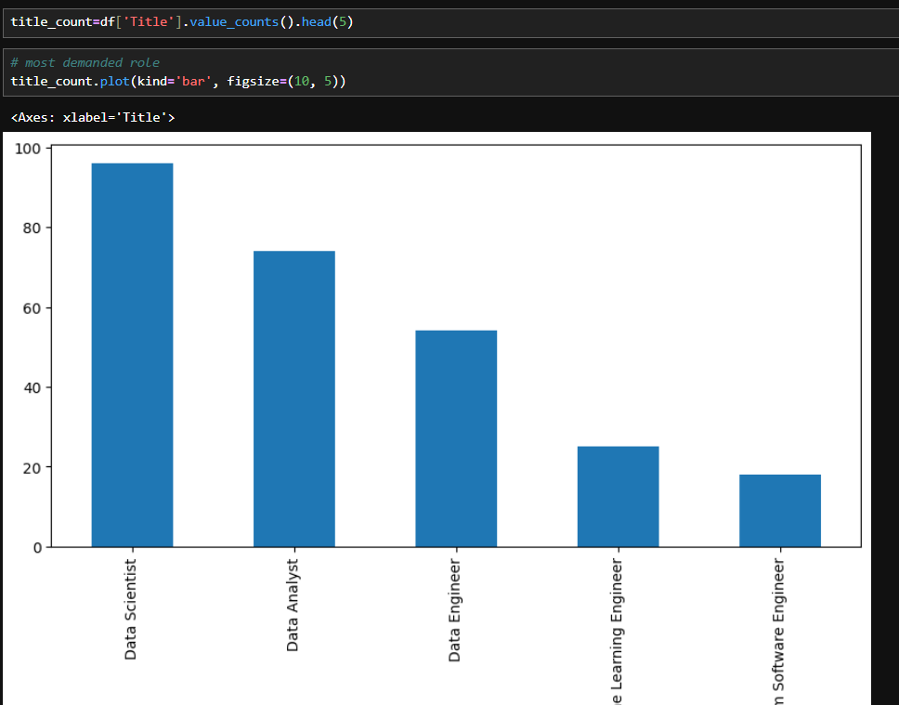
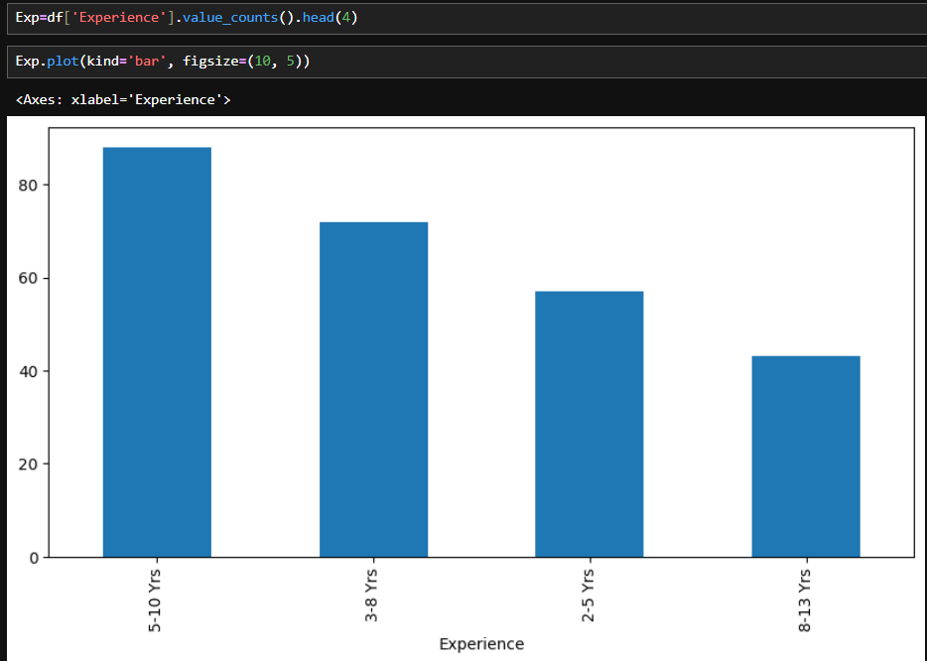
Univariate Analysis
Used the value count function to get the most demanding job role in the field of Data science and Data analysis, and similarly we visualized the experience required for the most jobs.

Slide 13
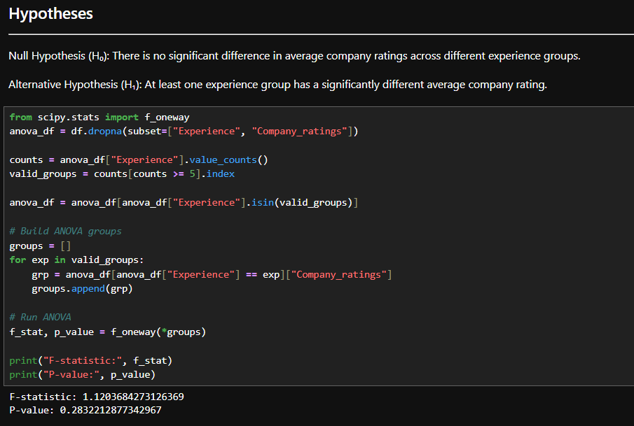
Hypothesis testing
Hypothesis testing in this project was performed to statistically examine whether company ratings vary significantly across different experience levels in job postings scraped from Naukri.com. A one-way ANOVA (Analysis of Variance) test was selected because the independent variable, Experience, is categorical (different experience ranges), while the dependent variable, Company_ratings, is numerical. The null hypothesis (H₀) stated that there is no significant difference in the average company ratings across experience groups, whereas the alternative hypothesis (H₁) stated that at least one experience group has a significantly different average rating. Before applying ANOVA, the data was cleaned by removing missing values, converting ratings to numeric format, and filtering experience groups with sufficient sample size to ensure statistical validity.
The ANOVA test produced an F-statistic of approximately 1.12 and a p-value of 0.28. Since the p-value is greater than the chosen significance level (α = 0.05), the null hypothesis was not rejected. This indicates that there is no statistically significant difference in company ratings across different experience levels. From a business and career perspective, this result suggests that higher experience requirements do not necessarily correspond to better-rated companies, emphasizing that job seekers should evaluate roles based on multiple factors such as skills, location, role fit, and growth opportunities rather than assuming experience level alone reflects employer quality.

Slide 14
Job Role Trends
The most frequently occurring roles are:
Data Scientist – 96 jobs
Data Analyst – 74 jobs
Data Engineer – 55 jobs
Machine Learning Engineer – 30 jobs
AI / ML Engineer – 27 jobs
Custom Software Engineer – 27 jobs
Salary Information
Salary data is available for only 123 jobs (many postings hide salary).
Available salaries range across wide bands such as 5–30 LPA, showing strong earning potential in data-related roles.
Experience Demand
Most demanded experience ranges:
5–10 years – 109 jobs
3–8 years – 84 jobs
2–5 years – 77 jobs
5–8 years – 75 jobs
1–3 years – 38 jobs
Insight:
Majority of jobs target mid-level professionals (2–10 years).
Fewer roles are available for complete freshers.

Slide 15
INTERPRETATION
The most in-demand roles are Data Scientist, Data Analyst, Data Engineer, and Machine Learning Engineer.
Hyderabad appears as the dominant job location, either alone or in hybrid/multi-city formats, indicating strong regional demand.
Most opportunities target mid-level professionals, especially in the 3–10 years experience range.
Salaries vary widely, with many roles offering packages between 5–30 Lacs per annum, showing strong earning potential in data-related careers.
Average company rating is around 3.6, giving students a benchmark for evaluating employers.
A large portion of jobs are recently posted, proving that the scraping system captures fresh and relevant opportunities.

Slide 16

Final Conclusion
Overall, this project proves that web scraping can be transformed into a practical job assistance system that:
Helps students and alumni discover relevant jobs faster
Improves placement outcomes for institutions
Provides market intelligence for curriculum planning
Enables data-driven career guidance
THANK YOU

